Slide 1
Introduction to SQL – Part 02

Slide 2
SQL – Aggregate Functions
Aggregate SQL functions can compute values over a column across many rows.
They include:
avg(x) – returns the average of all non-NULL values.
count(x) – returns the number on non-NULL values.
count( *) – returns the total number of rows.
max(x) – returns the maximum number in the group.
min(x) – returns the minimum number in the group.
sum(x) – returns the sum of all non-NULL values. If there are no non-NULL values it returns NULL.
total(x) – returns the sum of all non-NULL values. If there are no non-NULL values it returns 0.

Slide 3
SQL – Aggregate Functions
Compute the average loss of contact (rounded to 1 decimal place), using the precalculated LOCAverage field, for the walker with bib number 379:
SELECT
BibNumber, Round(avg(LOCAverage),1) as Average
FROM VideoObservation
WHERE BibNumber=379;
Result Set
BibNumber | Average
379 | 41.0

Slide 4
SQL – Aggregate Functions
Compute the average loss of contact for all walkers across all races, using the precalculated LOCAverage field:
SELECT Round(avg(LOCAverage),1) as Average
FROM VideoObservation;
Result Set
Average
41.9

Slide 5
SQL – Aggregate Functions
What if the question asked to compute the average loss of contact for each walker in race 1?
That's where the GROUP BY clause comes in.
In the simplest case, a GROUP BY clause aggregates the data performing the calculation on the collection of rows for each value in the GROUP BY clause.
For example:
SELECT BibNumber, Round(avg(LOCAverage),1) as Average
FROM VideoObservation
WHERE IDRace =1
GROUP BY BibNumber;
Result Set
BibNumber | Average
(null) | 33.1
100 | 41.1
101 | 47.8
102 | 32.8
103 | 42.2

Slide 6
SQL – Aggregate Functions
102
BibNumber | Average
102 | 34.4
102 | 41.7
102 | 34.4
102 | 20.8
NULL
BibNumber | Average
(null) | 42.7
(null) | 23.4
VideoObservation
BibNumber | Average
(null) | 42.7
(null) | 23.4
100 | 42.2
100 | 41.1
100 | 38.5
100 | 42.7
101 | 51
101 | 52.6
101 | 45.8
101 | 42.7
101 | 47.9
101 | 50
101 | 42.2
101 | 48.6
101 | 50
101 | 47
101 | 46.9
101 | 49
102 | 34.4
102 | 41.7
102 | 34.4
102 | 20.8
103 | 42.2
For example:
SELECT BibNumber, Round(avg(LOCAverage),1) as Average
FROM VideoObservation
WHERE IDRace =1
GROUP BY BibNumber;
33.1
47.8
100
BibNumber | Average
100 | 42.2
100 | 41.1
100 | 38.5
100 | 42.7
103
BibNumber | Average
102 | 42.2
Result Set
BibNumber | Average
(null) | 33.1
100 | 41.1
101 | 47.8
102 | 32.8
103 | 42.2
42.2
41.1
101
BibNumber | Average
101 | 51
101 | 52.6
101 | 45.8
101 | 42.7
101 | 47.9
101 | 50
101 | 42.2
101 | 48.6
101 | 50
101 | 47
101 | 46.9
101 | 49
47.8

Slide 7
SQL – Aggregate Functions
Compute the min and max loss of contact for all walkers across all races for each walker, using the precalculated LOCAverage field (Order by BibNumber):
SELECT BibNumber, MIN(LOCAverage) AS MinLOC, MAX(LOCAverage) AS MaxLOC
FROM VideoObservation
GROUP BY BibNumber
ORDER BY BibNumber;
Result Set
Average | MinLOC | MaxLOC
(null) | 23.4 | 42.7
100 | 38.5 | 42.7
101 | 42.2 | 52.6
102 | 20.8 | 41.7
… | ... | …

Slide 8
SQL – Aggregate Functions
102
BibNumber | Average
102 | 34.4
102 | 41.7
102 | 34.4
102 | 20.8
NULL
BibNumber | Average
(null) | 42.7
(null) | 23.4
VideoObservation
BibNumber | Average
(null) | 42.7
(null) | 23.4
100 | 42.2
100 | 41.1
100 | 38.5
100 | 42.7
101 | 51
101 | 52.6
101 | 45.8
101 | 42.7
101 | 47.9
101 | 50
101 | 42.2
101 | 48.6
101 | 50
101 | 47
101 | 46.9
101 | 49
102 | 34.4
102 | 41.7
102 | 34.4
102 | 20.8
103 | 42.2
SELECT BibNumber, MIN(LOCAverage) AS MinLOC,
MAX(LOCAverage) AS MaxLOC
FROM VideoObservation
GROUP BY BibNumber
ORDER BY BibNumber;
100
BibNumber | Average
100 | 42.2
100 | 41.1
100 | 38.5
100 | 42.7
103
BibNumber | Average
102 | 42.2
Result Set
Average | MinLOC | MaxLOC
(null) | 23.4 | 42.7
100 | 38.5 | 42.7
101 | 42.2 | 52.6
102 | 20.8 | 41.7
… | ... | …
101
BibNumber | Average
101 | 51
101 | 52.6
101 | 45.8
101 | 42.7
101 | 47.9
101 | 50
101 | 42.2
101 | 48.6
101 | 50
101 | 47
101 | 46.9
101 | 49

Slide 9
SQL – Aggregate Functions
An important point about utilizing a GROUP BY:
Each value returned from the SELECT statement must either be listed in the GROUP BY clause (multiple values may be listed) or the value must be enclosed in an aggregate function.
SELECT BibNumber, MIN(LOCAverage) AS MinLOC,
MAX(LOCAverage) AS MaxLOC
FROM VideoObservation
GROUP BY BibNumber
ORDER BY BibNumber;
Fields not in GROUP BY must be listed with an aggregate function
Fields in GROUP BY may be listed without an aggregate function

Slide 10
SQL – Aggregate Functions
GROUP BY clauses are not limited to a single field.
Write a query that returns the average AverageLOC (use the precalculated field for ease) for each gender for each country.
SELECT Round(Avg(LOCAverage),1) AS Average, A.CountryCode, A.Gender FROM
VideoObservation VO INNER JOIN Bib B ON VO.BibNumber = B.BibNumber
INNER JOIN Athlete A on B.IDAthlete = A.IDAthlete
GROUP BY A.CountryCode, A.Gender
ORDER BY A.CountryCode, A.Gender
Result Set
Average | CountryCode | Gender
40.8 | ARG | F
35.2 | AUS | F
38.6 | AUS | M
52.8 | BOL | M
37 | BRA | F
… | … | …

Slide 11
SQL – Aggregate Functions
SELECT Round(Avg(LOCAverage),1) AS Average, A.CountryCode, A.Gender FROM
VideoObservation VO INNER JOIN Bib B ON VO.BibNumber = B.BibNumber
INNER JOIN Athlete A on B.IDAthlete = A.IDAthlete
GROUP BY A.CountryCode, A.Gender
ORDER BY A.CountryCode, A.Gender
Joining three tables occurs before the GROUP BY and should be treated like any other INNER JOIN:
Athlete
IDAthlete | FirstName | LastName | CountryCode | Gender
1 | Lillie | Gill | FRA | F
2 | Lyla | Suarez | ITA | F
3 | Gwendolyn | French | MEX | F
Bib
IDRace | IDAthlete | BibNumber | FinishingTime | FinishingPlace | Finished
1 | 47 | 100 |  |  | DNS
1 | 21 | 102 | 2:57:55 | 21 | Yes
1 | 4 | 106 | 2:44:40 | 4 | Yes
1 | 36 | 107 | 3:16:11 | 36 | Yes
VideoObservation
ID | IDRace | BibNumber | IDObserver | LOCAverage | LOC1 | LOC2 | LOC3 | LOC4 | BentKneeAngle | Comment | VideoFile | TOD
600 | 2 | 348 | 3 | 20.3 | 0.75 | 3 | 3 | 3 | 0 |  | C0835 | 09:10 AM
936 | 3 | 100 | 1 | 38.5 | 4.25 | 4.75 | 4.5 | 5 | 177 | 177 | C0952 | 09:10 AM
1215 | 1 | 378 | 3 | 28.1 | 4 | 3.5 | 3.5 | 2.5 | 176 | 175.7 | C1093 | 09:10 AM
880 | 3 | 100 | 1 | 41.1 | 5 | 5.5 | 5 | 4.25 | 176 | 175.5 | C0963 | 09:10 AM

Slide 12
SQL – Aggregate Functions
SELECT Round(Avg(LOCAverage),1) AS Average, A.CountryCode, A.Gender FROM
VideoObservation VO INNER JOIN Bib B ON VO.BibNumber = B.BibNumber
INNER JOIN Athlete A on B.IDAthlete = A.IDAthlete
GROUP BY A.CountryCode, A.Gender
ORDER BY A.CountryCode, A.Gender
Joining three tables occurs before the GROUP BY and should be treated like any other INNER JOIN:
Athlete
IDAthlete | FirstName | LastName | CountryCode | Gender
1 | Lillie | Gill | FRA | F
2 | Lyla | Suarez | ITA | F
3 | Gwendolyn | French | MEX | F
Bib
IDRace | IDAthlete | BibNumber | FinishingTime | FinishingPlace | Finished
1 | 47 | 100 |  |  | DNS
1 | 21 | 102 | 2:57:55 | 21 | Yes
1 | 4 | 106 | 2:44:40 | 4 | Yes
1 | 36 | 107 | 3:16:11 | 36 | Yes
VideoObservation
ID | IDRace | BibNumber | IDObserver | LOCAverage | LOC1 | LOC2 | LOC3 | LOC4 | BentKneeAngle | Comment | VideoFile | TOD
600 | 2 | 348 | 3 | 20.3 | 0.75 | 3 | 3 | 3 | 0 |  | C0835 | 09:10 AM
936 | 3 | 100 | 1 | 38.5 | 4.25 | 4.75 | 4.5 | 5 | 177 | 177 | C0952 | 09:10 AM
1215 | 1 | 378 | 3 | 28.1 | 4 | 3.5 | 3.5 | 2.5 | 176 | 175.7 | C1093 | 09:10 AM
880 | 3 | 100 | 1 | 41.1 | 5 | 5.5 | 5 | 4.25 | 176 | 175.5 | C0963 | 09:10 AM

Slide 13
SQL – Aggregate Functions
Interim Data
Average | CountryCode | Gender | BibNumber
20.3 | AUS | M | 348
29.2 | AUS | M | 348
29.7 | AUS | M | 348
33.9 | AUS | M | 348
34.9 | AUS | M | 348
35.4 | AUS | M | 348
29.2 | AUS | M | 379
36.5 | AUS | M | 379
37.5 | AUS | M | 379
39.1 | AUS | M | 379
42.7 | AUS | M | 379
43.2 | AUS | M | 379
43.8 | AUS | M | 379
44.8 | AUS | M | 379
45.8 | AUS | M | 379
47.5 | AUS | M | 379
29.2 | AUS | M | 379
36.5 | AUS | M | 379
37.5 | AUS | M | 379
39.1 | AUS | M | 379
42.7 | AUS | M | 379
43.2 | AUS | M | 379
43.8 | AUS | M | 379
44.8 | AUS | M | 379
45.8 | AUS | M | 379
47.5 | AUS | M | 379
SELECT Round(Avg(LOCAverage),1) AS Average, A.CountryCode, A.Gender FROM
VideoObservation VO INNER JOIN Bib B ON VO.BibNumber = B.BibNumber
INNER JOIN Athlete A on B.IDAthlete = A.IDAthlete GROUP BY A.CountryCode, A.Gender
ORDER BY A.CountryCode, A.Gender
Each average is computed for each distinct value of CountryCode and Gender:
38.6
Result Set
Average | CountryCode | Gender
40.8 | ARG | F
35.2 | AUS | F
38.6 | AUS | M
52.8 | BOL | M
37 | BRA | F
… | … | …

Slide 14
SQL – Aggregate Functions
Interim Data
Interim Data
Average | CountryCode | Gender | BibNumber
33.3 | ARG | F | 140
37 | ARG | F | 140
41.1 | ARG | F | 140
41.7 | ARG | F | 140
51 | ARG | F | 140
10.4 | AUS | F | 126
19.8 | AUS | F | 126
20.8 | AUS | F | 126
20.8 | AUS | F | 137
28.1 | AUS | F | 137
33.3 | AUS | F | 137
33.3 | AUS | F | 137
36.5 | AUS | F | 137
44.8 | AUS | F | 137
18.8 | AUS | F | 144
35.9 | AUS | F | 144
39.1 | AUS | F | 144
50 | AUS | F | 144
51 | AUS | F | 144
51 | AUS | F | 144
45.8 | AUS | F | 169
59 | AUS | F | 169
SELECT Round(Avg(LOCAverage),1) AS Average, A.CountryCode, A.Gender FROM
VideoObservation VO INNER JOIN Bib B ON VO.BibNumber = B.BibNumber
INNER JOIN Athlete A on B.IDAthlete = A.IDAthlete GROUP BY A.CountryCode, A.Gender
ORDER BY A.CountryCode, A.Gender
Each average is computed for each distinct value of
40.8
35.2
Result Set
Average | CountryCode | Gender
40.8 | ARG | F
35.2 | AUS | F
38.6 | AUS | M
52.8 | BOL | M
37 | BRA | F
… | … | …

Slide 15
SQL – Aggregate Functions
Interim Data
Average | CountryCode | Gender | BibNumber
46.4 | BOL | M | 366
49 | BOL | M | 366
49 | BOL | M | 366
51.6 | BOL | M | 366
52.1 | BOL | M | 366
57.3 | BOL | M | 366
58.3 | BOL | M | 366
58.9 | BOL | M | 366
42.2 | BRA | F | 103
18.8 | BRA | F | 161
25 | BRA | F | 161
32.8 | BRA | F | 161
39.6 | BRA | F | 180
44.8 | BRA | F | 180
45.3 | BRA | F | 180
45.3 | BRA | F | 180
46.5 | BRA | F | 180
47.4 | BRA | F | 180
47.9 | BRA | F | 180
47.9 | BRA | F | 180
20.8 | BRA | F | 183
25 | BRA | F | 183
25 | BRA | F | 183
SELECT Round(Avg(LOCAverage),1) AS Average, A.CountryCode, A.Gender FROM
VideoObservation VO INNER JOIN Bib B ON VO.BibNumber = B.BibNumber
INNER JOIN Athlete A on B.IDAthlete = A.IDAthlete GROUP BY A.CountryCode, A.Gender
ORDER BY A.CountryCode, A.Gender
Each average is computed for each distinct value of CountryCode and Gender:
52.8
Average | CountryCode | Gender
40.8 | ARG | F
35.2 | AUS | F
38.6 | AUS | M
52.8 | BOL | M
37 | BRA | F
… | … | …
37

Slide 16
SQL – Aggregate Functions
Where it gets more interesting is filtering the results of a query with a GROUP BY clause.
If you only want the average AverageLOC (use the precalculated field for ease) for BibNumbers 100 & 101, the following query works:
SELECT BibNumber, Round(AVG(LOCAverage),1) AS AverageLOC
FROM VideoObservation
WHERE BibNumber = 100 OR BibNumber = 101
GROUP BY BibNumber
ORDER BY BibNumber;
Result Set
BibNumber | AverageLOC
100 | 41.1
101 | 47.8

Slide 17
SQL – Aggregate Functions
Interim Result Set
BibNumber | LOCAverage
100 | 42.2
100 | 41.1
100 | 38.5
100 | 42.7
101 | 51
101 | 52.6
101 | 45.8
101 | 42.7
101 | 47.9
101 | 50
101 | 42.2
101 | 48.6
101 | 50
101 | 47
101 | 46.9
101 | 49
SELECT BibNumber, Round(AVG(LOCAverage),1) AS AverageLOC
FROM VideoObservation
WHERE BibNumber = 100 OR BibNumber = 101
GROUP BY BibNumber
ORDER BY BibNumber;
What’s happening behind the scenes?
41.1
47.8
Result Set
BibNumber | AverageLOC
100 | 41.1
101 | 47.8

Slide 18
SQL – Aggregate Functions
Interim Result Set
BibNumber | AverageLOC
100 | 42.2
100 | 41.1
100 | 38.5
100 | 42.7
101 | 51
101 | 52.6
101 | 45.8
101 | 42.7
101 | 47.9
101 | 50
101 | 42.2
101 | 48.6
101 | 50
101 | 47
101 | 46.9
101 | 49
104 | 2.1
104 | 16.7
104 | 4.2
104 | 25
104 | 25
104 | 21.9
104 | 50
Change the query so now it returns the average loss of contact for walkers with a bib number of 100, 101 or 104 for all laps where the loss of contact was over 45 ms.
SELECT BibNumber, Round(AVG(LOCAverage),1) AS AverageLOC
FROM VideoObservation
WHERE (BibNumber = 100 OR BibNumber = 101 OR BibNumber = 104) AND LOCAverage > 45
GROUP BY BibNumber
ORDER BY BibNumber;
Result Set
BibNumber | AverageLOC
101 | 48.9
104 | 50

Slide 19
SQL – Aggregate Functions
Interim Result Set
BibNumber | AverageLOC
100 | 42.2
100 | 41.1
100 | 38.5
100 | 42.7
101 | 51
101 | 52.6
101 | 45.8
101 | 42.7
101 | 47.9
101 | 50
101 | 42.2
101 | 48.6
101 | 50
101 | 47
101 | 46.9
101 | 49
104 | 2.1
104 | 16.7
104 | 4.2
104 | 25
104 | 25
104 | 21.9
104 | 50
Change the query so now it returns the average loss of contact for walkers with a bib number of 100, 101 or 104 for all laps where the loss of contact was over 45 ms.
SELECT BibNumber, Round(AVG(LOCAverage),1) AS AverageLOC
FROM VideoObservation
WHERE (BibNumber = 100 OR BibNumber = 101 or BibNumber = 104 ) AND LOCAverage > 45
GROUP BY BibNumber
ORDER BY BibNumber;
Result Set
BibNumber | AverageLOC
101 | 48.9
104 | 50

Slide 20
SQL – Aggregate Functions
Interim Result Set
BibNumber | AverageLOC
101 | 51
101 | 52.6
101 | 45.8
101 | 47.9
101 | 50
101 | 48.6
101 | 50
101 | 47
101 | 46.9
101 | 49
104 | 50
48.9
Change the query so now it returns the average loss of contact for walkers with a bib number of
100, 101 or 104 for all laps where the loss of contact was over 45 ms.
SELECT BibNumber, Round(AVG(LOCAverage),1) AS AverageLOC
FROM VideoObservation
WHERE (BibNumber = 100 OR BibNumber = 101 or BibNumber = 104 ) AND LOCAverage > 45
GROUP BY BibNumber
ORDER BY BibNumber;
50
Result Set
BibNumber | AverageLOC
101 | 48.9
104 | 50

Slide 21
SQL – Aggregate Functions
Change the query so now it returns the average loss of contact for walkers with a bib number of 100, 101 or 104 for all laps where the loss of contact was over average to 45 ms.
For example:
a walker with Bib Number 1 and 3 laps @ 43, 42, and 53 averages over 45 and is included as:
1, 46 ms, all three values are used to compute the average and it is included because the average is over 45 ms.
A walker with Bib Number 2 and 3 laps @ 43, 43, 46 is not included at all because the average is 44.

Slide 22
SQL – Aggregate Functions
What if the only bib numbers of athletes with an average loss of contact of more than 45 ms across all observations should be returned?
This means the AverageLOC must be calculated for each BibNumber and then the filter must be applied to that value.
This requires a new clause to be added to the SQL statement, the HAVING clause.
A HAVING clause appears after the GROUP BY clause.
Any conditions applied in the HAVING clause effect the results of the rows returned after the GROUP BY clause and any WHERE clause filters are applied.
HAVING clauses typically check aggregate values like MIN, MAX, AVG, SUM, COUNT, etc.

Slide 23
SQL – Aggregate Functions
Write a query that returns the average loss of contact for walkers with a bib number of 100, 101 or 104 for all laps where the loss of contact was over average to 45 ms.
SELECT BibNumber, Round(AVG(LOCAverage),1) AS AverageLOC
FROM VideoObservation
WHERE (BibNumber = 100 OR BibNumber = 101 or BibNumber = 104 )
GROUP BY BibNumber
HAVING AVG(LOCAverage) > 45
ORDER BY BibNumber;
Result Set
BibNumber | AverageLOC
101 | 47.8

Slide 24
SQL – Aggregate Functions
Result Set
BibNumber | LOCAverage
100 | 42.2
100 | 41.1
100 | 38.5
100 | 42.7
101 | 51
101 | 52.6
101 | 45.8
101 | 42.7
101 | 47.9
101 | 50
101 | 42.2
101 | 48.6
101 | 50
101 | 47
101 | 46.9
101 | 49
102 | 34.4
102 | 41.7
102 | 34.4
102 | 20.8
103 | 42.2
104 | 2.1
104 | 16.7
104 | 4.2
104 | 25
104 | 25
104 | 21.9
104 | 50
Write a query that returns the average loss of contact for walkers with a bib number of 100, 101 or 104 for all laps where the loss of contact was over average to 45 ms.
SELECT BibNumber, Round(AVG(LOCAverage),1) AS AverageLOC
FROM VideoObservation
WHERE (BibNumber = 100 OR BibNumber = 101 or BibNumber = 104)
GROUP BY BibNumber
HAVING AVG(LOCAverage) > 45
ORDER BY BibNumber;
First, the WHERE clause is evaluated:
Result Set
BibNumber | AverageLOC
101 | 47.8

Slide 25
SQL – Aggregate Functions
Interim Result Set
BibNumber | LOCAverage
100 | 42.2
100 | 41.1
100 | 38.5
100 | 42.7
101 | 51
101 | 52.6
101 | 45.8
101 | 42.7
101 | 47.9
101 | 50
101 | 42.2
101 | 48.6
101 | 50
101 | 47
101 | 46.9
101 | 49
104 | 2.1
104 | 16.7
104 | 4.2
104 | 25
104 | 25
104 | 21.9
104 | 50
41.1
Write a query that returns the average loss of contact for walkers with a bib number of 100, 101 or 104 for all laps where the loss of contact was over average to 45 ms.
SELECT BibNumber, Round(AVG(LOCAverage),1) AS AverageLOC
FROM VideoObservation
WHERE (BibNumber = 100 OR BibNumber = 101 or BibNumber = 104 )
GROUP BY BibNumber
HAVING AVG(LOCAverage) > 45
ORDER BY BibNumber;
The remaining rows are grouped and the average for the group is calculated:
47.8
20.7
Result Set
BibNumber | AverageLOC
101 | 47.8

Slide 26
SQL – Aggregate Functions
Interim Result Set
BibNumber | LOCAverage
100 | 42.2
100 | 41.1
100 | 38.5
100 | 42.7
101 | 51
101 | 52.6
101 | 45.8
101 | 42.7
101 | 47.9
101 | 50
101 | 42.2
101 | 48.6
101 | 50
101 | 47
101 | 46.9
101 | 49
104 | 2.1
104 | 16.7
104 | 4.2
104 | 25
104 | 25
104 | 21.9
104 | 50
41.1
Write a query that returns the average loss of contact for walkers with a bib number of 100, 101 or 104 for all laps where the loss of contact was over average to 45 ms.
SELECT BibNumber, Round(AVG(LOCAverage),1) AS AverageLOC
FROM VideoObservation
WHERE (BibNumber = 100 OR BibNumber = 101 or BibNumber = 104 )
GROUP BY BibNumber
HAVING AVG(LOCAverage) > 45
ORDER BY BibNumber;
Then the aggregated values are filtered out:
47.8
20.7
Result Set
BibNumber | AverageLOC
101 | 47.8

Slide 27
SQL – Aggregate Functions
Write a query to return the judge names and how many red cards they gave for bent knee for judges who gave at least 3 bent knee red cards in the 35km Boonta Eve Classic.
Event
IDEvent | Event | City | Country
1 | Boonta Eve Classic | Mos Espa | Tatooine
Race
IDRace | IDEvent | RaceDate | StartTime | Distance | DistanceUnits | Gender
1 | 1 | 2023-08-24 | 7:00 AM | 35 | km | MF
2 | 1 | 2023-08-19 | 10:50 AM | 20 | km | M
3 | 1 | 2023-08-20 | 7:15 AM | 20 | km | F
Judge
IDJudge | FirstName | LastName | CountryCode
1 | Qui-Gon | Jinn | FRA
2 | Asajj | Ventress | POR
3 | Kit | Fisto | FIN
4 | Leia | Organa | CAN
5 | Ahsoka | Tano | ARG
6 | Jeff | Salvage | USA
7 | Mace | Windu | ESP
8 | Obi-Wan | Kenobi | HKG
JudgeCall
IDJudge | IDRace | Color | Infraction | TOD | BibNumber
1 | 1 | Yellow | ~ | 9:16:00 AM | 106
1 | 1 | Yellow | ~ | 9:21:00 AM | 159
1 | 1 | Red | < | 9:33:00 AM | 181
1 | 1 | Yellow | ~ | 7:34:00 AM | 181
1 | 1 | Yellow | < | 9:11:00 AM | 181
1 | 1 | Yellow | < | 7:44:00 AM | 102
1 | 1 | Yellow | ~ | 8:48:00 AM | 140
1 | 1 | Red | < | 8:04:00 AM | 142
1 | 1 | Yellow | < | 7:35:00 AM | 142
1 | 1 | Yellow | ~ | 7:35:00 AM | 182
1 | 1 | Yellow | < | 7:15:00 AM | 172
1 | 1 | Yellow | < | 9:09:00 AM | 167
1 | 1 | Yellow | < | 8:13:00 AM | 351
… | … | … | … | … | …

Slide 28
SQL – Aggregate Functions
Write a query to return the judge names and how many red cards they gave for bent knee for judges who gave at least 3 bent knee red cards in the 35km Boonta Eve Classic.
Final Result Set
FirstName | LastName | NbrInfractions
Kit | Fisto | 15
Qui-Gon | Jinn | 8
Leia | Organa | 7
Jeff | Salvage | 5
Ahsoka | Tano | 9
Asajj | Ventress | 5
Mace | Windu | 4

Slide 29
SQL – Aggregate Functions
Write a query to return the judge names and how many red cards they gave for bent knee for judges who gave at least 3 bent knee red cards in the 35km Boonta Eve Classic.
Start by connecting the tables with appropriate joins:
Event
IDEvent | Event | City | Country
1 | Boonta Eve Classic | Mos Espa | Tatooine
Race
IDRace | IDEvent | RaceDate | StartTime | Distance | DistanceUnits | Gender
1 | 1 | 2023-08-24 | 7:00 AM | 35 | km | MF
2 | 1 | 2023-08-19 | 10:50 AM | 20 | km | M
3 | 1 | 2023-08-20 | 7:15 AM | 20 | km | F
Judge
IDJudge | FirstName | LastName | CountryCode
1 | Qui-Gon | Jinn | FRA
2 | Asajj | Ventress | POR
3 | Kit | Fisto | FIN
4 | Leia | Organa | CAN
5 | Ahsoka | Tano | ARG
6 | Jeff | Salvage | USA
7 | Mace | Windu | ESP
8 | Obi-Wan | Kenobi | HKG
JudgeCall
IDJudge | IDRace | Color | Infraction | TOD | BibNumber
1 | 1 | Yellow | ~ | 9:16:00 AM | 106
1 | 1 | Yellow | ~ | 9:21:00 AM | 159
1 | 1 | Red | < | 9:33:00 AM | 181
1 | 1 | Yellow | ~ | 7:34:00 AM | 181
1 | 1 | Yellow | < | 9:11:00 AM | 181
1 | 1 | Yellow | < | 7:44:00 AM | 102
1 | 1 | Yellow | ~ | 8:48:00 AM | 140
1 | 1 | Red | < | 8:04:00 AM | 142
1 | 1 | Yellow | < | 7:35:00 AM | 142
1 | 1 | Yellow | ~ | 7:35:00 AM | 182
1 | 1 | Yellow | < | 7:15:00 AM | 172
1 | 1 | Yellow | < | 9:09:00 AM | 167
1 | 1 | Yellow | < | 8:13:00 AM | 351
… | … | … | … | … | …

Slide 30
SQL – Aggregate Functions
The order of evaluation is determined by the optimized, but for evaluation purposes can be done in any order.
Observe limiting the results by the WHERE clause and INNER JOIN between the Event & Race tables first:
FROM Race INNER JOIN Event ON Race.IDEvent = Event.IDEvent
WHERE Event.Event = 'Boonta Eve Classic' AND Race.Distance = 35 AND Race.DistanceUnits = "km"
Event
IDEvent | Event | City | Country
1 | Boonta Eve Classic | Mos Espa | Tatooine
Race
IDRace | IDEvent | RaceDate | StartTime | Distance | DistanceUnits | Gender
1 | 1 | 2023-08-24 | 7:00 AM | 35 | km | MF
2 | 1 | 2023-08-19 | 10:50 AM | 20 | km | M
3 | 1 | 2023-08-20 | 7:15 AM | 20 | km | F
Interim Result Set |  |  |  | Interim Result Set
IDEvent | Event | City | Country | IDRace | IDEvent | RaceDate | StartTime | Distance | DistanceUnits | Gender
1 | Boonta Eve Classic | Mos Espa | Tatooine | 1 | 1 | 08/24/2023 | 7:00 AM | 35 | km | MF

Slide 31
SQL – Aggregate Functions
Next, join the JudgeCall table:
FROM Race INNER JOIN Event ON Race.IDEvent = Event.IDEvent
INNER JOIN JudgeCall ON JudgeCall.IDRace = Race.IDRace
WHERE Event.Event = 'Boonta Eve Classic' AND Race.Distance = 35 AND Race.DistanceUnits = "km"
Interim Result Set |  |  |  | Interim Result Set
IDEvent | Event | City | Country | IDRace | IDEvent | RaceDate | StartTime | Distance | DistanceUnits | Gender
1 | Boonta Eve Classic | Mos Espa | Tatooine | 1 | 1 | 08/24/2023 | 7:00 AM | 35 | km | MF
JudgeCall
IDJudge | IDRace | Color | Infraction | TOD | BibNumber
1 | 1 | Yellow | ~ | 9:16:00 AM | 106
1 | 1 | Yellow | ~ | 9:21:00 AM | 159
1 | 1 | Red | < | 9:33:00 AM | 181
1 | 1 | Yellow | ~ | 7:34:00 AM | 181
1 | 1 | Yellow | < | 9:11:00 AM | 181
… | … | … | … | … | …
3 | 3 | Yellow | ~ | 7:30:00 AM | 100
3 | 8 | Red | ~ | 7:45:00 AM | 100
3 | 8 | Yellow | ~ | 7:28:00 AM | 100
3 | 2 | Yellow | ~ | 7:40:00 AM | 101
3 | 3 | Yellow | ~ | 8:34:00 AM | 101
… | … | … | … | … | …
2 | 3 | Red | ~ | 11:06:00 AM | 300
2 | 3 | Yellow | ~ | 10:56:00 AM | 300

Slide 32
SQL – Aggregate Functions
At this point, the only data needed is from the JudgeCall table.
Observe, the interim results:
Interim Result Set (limited field list)
IDRace | IDJudge | Color | Infraction | TOD | BibNumber
1 | 1 | Red | < | 8:04:00 AM | 142
1 | 1 | Red | < | 9:33:00 AM | 181
1 | 1 | Red | < | 8:20:00 AM | 183
1 | 1 | Red | < | 8:42:00 AM | 326
1 | 1 | Red | < | 8:37:00 AM | 329
1 | 1 | Red | < | 8:31:00 AM | 351
1 | 1 | Red | < | 8:24:00 AM | 372
1 | 1 | Red | < | 8:00:00 AM | 378
1 | 1 | Red | ~ | 7:31:00 AM | 312
1 | 1 | Red | ~ | 7:59:00 AM | 368
1 | 1 | Yellow | < | 7:44:00 AM | 102
1 | 1 | Yellow | < | 7:35:00 AM | 142
1 | 1 | Yellow | < | 9:09:00 AM | 167
1 | 1 | Yellow | < | 7:15:00 AM | 172
1 | 1 | Yellow | < | 9:11:00 AM | 181
1 | 1 | Yellow | < | 7:36:00 AM | 183
1 | 1 | Yellow | < | 7:38:00 AM | 304
1 | 1 | Yellow | < | 9:14:00 AM | 307
1 | 1 | Yellow | < | 9:29:00 AM | 309
There are still more fields to add to the WHERE clause, to only select the infractions that are red cards for bent knee.

Slide 33
SQL – Aggregate Functions
Now add the complete criteria for the WHERE clause:
Race INNER JOIN Event ON Race.IDEvent = Event.IDEvent
INNER JOIN JudgeCall ON JudgeCall.IDRace = Race.IDRace
WHERE Event.Event = 'Boonta Eve Classic' AND Race.Distance = 35 AND Race.DistanceUnits = "km"
AND JudgeCall.Color = 'Red' and JudgeCall.Infraction = '<'
ORDER BY JudgeCall.IDJudge
Interim Result Set (limited field list)
IDRace | IDJudge | Color | Infraction | TOD | BibNumber
1 | 1 | Red | < | 8:04:00 AM | 142
1 | 1 | Red | < | 9:33:00 AM | 181
1 | 1 | Red | < | 8:20:00 AM | 183
1 | 1 | Red | < | 8:42:00 AM | 326
1 | 1 | Red | < | 8:37:00 AM | 329
1 | 1 | Red | < | 8:31:00 AM | 351
1 | 1 | Red | < | 8:24:00 AM | 372
1 | 1 | Red | < | 8:00:00 AM | 378
1 | 2 | Red | < | 8:38:00 AM | 142
1 | 2 | Red | < | 8:16:00 AM | 183
1 | 2 | Red | < | 8:00:00 AM | 347
1 | 2 | Red | < | 8:03:00 AM | 371
1 | 2 | Red | < | 7:54:00 AM | 378
1 | 3 | Red | < | 8:21:00 AM | 108
1 | 3 | Red | < | 9:18:00 AM | 127
1 | 3 | Red | < | 8:56:00 AM | 133
1 | 3 | Red | < | 7:37:00 AM | 142
1 | 3 | Red | < | 9:26:00 AM | 167
1 | 3 | Red | < | 9:41:00 AM | 181
1 | 3 | Red | < | 7:56:00 AM | 183

Slide 34
SQL – Aggregate Functions
Next, join the Judge table to the query so the names of the judges can be returned instead of just their IDs.
Race INNER JOIN Event ON Race.IDEvent = Event.IDEvent
INNER JOIN JudgeCall ON JudgeCall.IDRace = Race.IDRace
INNER JOIN Judge on Judge.IDJudge = JudgeCall.IDJudge
WHERE Event.Event = 'Boonta Eve Classic' AND Race.Distance = 35 AND Race.DistanceUnits = "km"
AND JudgeCall.Color = 'Red' and JudgeCall.Infraction = '<'
Judge
IDJudge | FirstName | LastName | CountryCode
1 | Qui-Gon | Jinn | FRA
2 | Asajj | Ventress | POR
3 | Kit | Fisto | FIN
4 | Leia | Organa | CAN
5 | Ahsoka | Tano | ARG
6 | Jeff | Salvage | USA
7 | Mace | Windu | ESP
8 | Obi-Wan | Kenobi | HKG
Interim Result Set (limited field list)
IDRace | IDJudge | Color | Infraction | TOD | BibNumber
1 | 1 | Red | < | 8:04:00 AM | 142
1 | 1 | Red | < | 9:33:00 AM | 181
1 | 1 | Red | < | 8:20:00 AM | 183
1 | 1 | Red | < | 8:42:00 AM | 326
1 | 1 | Red | < | 8:37:00 AM | 329
1 | 1 | Red | < | 8:31:00 AM | 351
1 | 1 | Red | < | 8:24:00 AM | 372
1 | 1 | Red | < | 8:00:00 AM | 378
1 | 2 | Red | < | 8:38:00 AM | 142
1 | 2 | Red | < | 8:16:00 AM | 183
1 | 2 | Red | < | 8:00:00 AM | 347
1 | 2 | Red | < | 8:03:00 AM | 371
1 | 2 | Red | < | 7:54:00 AM | 378
1 | 3 | Red | < | 8:21:00 AM | 108
1 | 3 | Red | < | 9:18:00 AM | 127
1 | 3 | Red | < | 8:56:00 AM | 133
1 | 3 | Red | < | 7:37:00 AM | 142
1 | 3 | Red | < | 9:26:00 AM | 167
1 | 3 | Red | < | 9:41:00 AM | 181
1 | 3 | Red | < | 7:56:00 AM | 183

Slide 35
SQL – Aggregate Functions
This leaves just the rows in JudgeCall with an IDRace = 1 as well as removing records from JudgeCall where Color = "Yellow" or the Infraction = "~".
This greatly simplifies the evaluation:
Event
IDEvent | Event | City | Country
1 | Boonta Eve Classic | Mos Espa | Tatooine
Race
IDRace | IDEvent | RaceDate | StartTime | Distance | DistanceUnits | Gender
1 | 1 | 2023-08-24 | 7:00 AM | 35 | km | MF
2 | 1 | 2023-08-19 | 10:50 AM | 20 | km | M
3 | 1 | 2023-08-20 | 7:15 AM | 20 | km | F
Judge
IDJudge | FirstName | LastName | CountryCode
1 | Qui-Gon | Jinn | FRA
2 | Asajj | Ventress | POR
3 | Kit | Fisto | FIN
4 | Leia | Organa | CAN
5 | Ahsoka | Tano | ARG
6 | Jeff | Salvage | USA
7 | Mace | Windu | ESP
8 | Obi-Wan | Kenobi | HKG
JudgeCall
IDJudge | IDRace | Color | Infraction | TOD | BibNumber
1 | 1 | Yellow | ~ | 9:16:00 AM | 106
1 | 1 | Yellow | ~ | 9:21:00 AM | 159
1 | 1 | Red | < | 9:33:00 AM | 181
1 | 1 | Yellow | ~ | 7:34:00 AM | 181
1 | 1 | Yellow | < | 9:11:00 AM | 181
… | … | … | … | … | …
3 | 3 | Yellow | ~ | 7:30:00 AM | 100
3 | 8 | Red | ~ | 7:45:00 AM | 100
3 | 8 | Yellow | ~ | 7:28:00 AM | 100
3 | 2 | Yellow | ~ | 7:40:00 AM | 101
3 | 3 | Yellow | ~ | 8:34:00 AM | 101
… | … | … | … | … | …
2 | 3 | Red | ~ | 11:06:00 AM | 300
2 | 3 | Yellow | ~ | 10:56:00 AM | 300

Slide 36
SQL – Aggregate Functions
This leaves just the rows in JudgeCall with a IDRace = 1 as well as removing records from JudgeCall where Color = "Yellow" or the Infraction = "~".
This greatly simplifies the evaluation:
Interim Result Set
IDRace | IDJudge | Color | Infraction | TOD | BibNumber
1 | 3 | Red | < | 8:21:00 AM | 108
1 | 3 | Red | < | 9:18:00 AM | 127
1 | 3 | Red | < | 8:56:00 AM | 133
1 | 3 | Red | < | 7:37:00 AM | 142
1 | 3 | Red | < | 9:26:00 AM | 167
1 | 3 | Red | < | 9:41:00 AM | 181
1 | 3 | Red | < | 9:41:00 AM | 184
1 | 3 | Red | < | 7:56:00 AM | 183
1 | 3 | Red | < | 9:20:00 AM | 306
1 | 3 | Red | < | 7:20:00 AM | 326
1 | 3 | Red | < | 7:50:00 AM | 301
1 | 3 | Red | < | 8:50:00 AM | 312
1 | 3 | Red | < | 9:16:00 AM | 316
1 | 3 | Red | < | 8:10:00 AM | 379
1 | 3 | Red | < | 9:31:00 AM | 361
1 | 1 | Red | < | 8:04:00 AM | 142
1 | 1 | Red | < | 9:33:00 AM | 181
1 | 1 | Red | < | 8:20:00 AM | 183
1 | 1 | Red | < | 8:37:00 AM | 329
1 | 1 | Red | < | 8:42:00 AM | 326
1 | 1 | Red | < | 8:31:00 AM | 351
1 | 1 | Red | < | 8:24:00 AM | 372
1 | 1 | Red | < | 8:00:00 AM | 378
… | … | … | … | … | …

Slide 37
SQL – Aggregate Functions
There is still one more join needed, which is to link the Judge table so the first and last names of the judges can be used instead of the IDJudge field:
Race INNER JOIN Event ON Race.IDEvent = Event.IDEvent
INNER JOIN JudgeCall ON JudgeCall.IDRace = Race.IDRace
INNER JOIN Judge on Judge.IDJudge = JudgeCall.IDJudge
WHERE Event.Event = 'Boonta Eve Classic' AND Race.Distance = 35 AND Race.DistanceUnits = "km"
AND JudgeCall.Color = 'Red' and JudgeCall.Infraction = '<'
ORDER BY Judge.LastName, Judge.FirstName, Judge.IDJudge
Interim Result Set
IDRace | IDJudge | Color | Infraction | TOD | BibNumber | FirstName | LastName
1 | 3 | Red | < | 8:21:00 AM | 108 | Kit | Fisto
1 | 3 | Red | < | 9:18:00 AM | 127 | Kit | Fisto
1 | 3 | Red | < | 8:56:00 AM | 133 | Kit | Fisto
1 | 3 | Red | < | 7:37:00 AM | 142 | Kit | Fisto
1 | 3 | Red | < | 9:26:00 AM | 167 | Kit | Fisto
1 | 3 | Red | < | 9:41:00 AM | 181 | Kit | Fisto
1 | 3 | Red | < | 9:41:00 AM | 184 | Kit | Fisto
1 | 3 | Red | < | 7:56:00 AM | 183 | Kit | Fisto
1 | 3 | Red | < | 9:20:00 AM | 306 | Kit | Fisto
1 | 3 | Red | < | 7:20:00 AM | 326 | Kit | Fisto
1 | 3 | Red | < | 7:50:00 AM | 301 | Kit | Fisto
1 | 3 | Red | < | 8:50:00 AM | 312 | Kit | Fisto
1 | 3 | Red | < | 9:16:00 AM | 316 | Kit | Fisto
1 | 3 | Red | < | 8:10:00 AM | 379 | Kit | Fisto
1 | 3 | Red | < | 9:31:00 AM | 361 | Kit | Fisto
1 | 1 | Red | < | 8:04:00 AM | 142 | Qui-Gon | Jinn
1 | 1 | Red | < | 9:33:00 AM | 181 | Qui-Gon | Jinn
1 | 1 | Red | < | 8:20:00 AM | 183 | Qui-Gon | Jinn
… | … | … | … | … | …

Slide 38
SQL – Aggregate Functions
Interim Result Set
IDJudge | FirstName | LastName
3 | Kit | Fisto
3 | Kit | Fisto
3 | Kit | Fisto
3 | Kit | Fisto
3 | Kit | Fisto
3 | Kit | Fisto
3 | Kit | Fisto
3 | Kit | Fisto
3 | Kit | Fisto
3 | Kit | Fisto
3 | Kit | Fisto
3 | Kit | Fisto
3 | Kit | Fisto
3 | Kit | Fisto
3 | Kit | Fisto
1 | Qui-Gon | Jinn
1 | Qui-Gon | Jinn
1 | Qui-Gon | Jinn
1 | Qui-Gon | Jinn
1 | Qui-Gon | Jinn
1 | Qui-Gon | Jinn
1 | Qui-Gon | Jinn
1 | Qui-Gon | Jinn
8 | Obi-Wan | Kenobi
8 | Obi-Wan | Kenobi
4 | Leia | Organa
4 | Leia | Organa
4 | Leia | Organa
4 | Leia | Organa
4 | Leia | Organa
4 | Leia | Organa
…
Count = 15
Grouping the data is next.
Add the GROUP BY statement on IDJudge, Color and Infraction:
Select Judge.FirstName, Judge.LastName, COUNT(JudgeCall.IDJudge) AS NbrInfractions
FROM Race INNER JOIN Event ON Race.IDEvent = Event.IDEvent
INNER JOIN JudgeCall ON JudgeCall.IDRace = Race.IDRace
INNER JOIN Judge on Judge.IDJudge = JudgeCall.IDJudge
WHERE Event.Event = 'Boonta Eve Classic' AND
Race.Distance = 35 AND Race.DistanceUnits = "km"
AND JudgeCall.Color = 'Red' and JudgeCall.Infraction = '<'
GROUP BY JudgeCall.IDJudge, JudgeCall.Color, JudgeCall.Infraction
ORDER BY Judge.LastName, Judge.FirstName, Judge.IDJudge
Count = 8
Count = 2
Count = 7

Slide 39
SQL – Aggregate Functions
Interim Result Set
IDJudge | FirstName | LastName
3 | Kit | Fisto
3 | Kit | Fisto
3 | Kit | Fisto
3 | Kit | Fisto
3 | Kit | Fisto
3 | Kit | Fisto
3 | Kit | Fisto
3 | Kit | Fisto
3 | Kit | Fisto
3 | Kit | Fisto
3 | Kit | Fisto
3 | Kit | Fisto
3 | Kit | Fisto
3 | Kit | Fisto
3 | Kit | Fisto
1 | Qui-Gon | Jinn
1 | Qui-Gon | Jinn
1 | Qui-Gon | Jinn
1 | Qui-Gon | Jinn
1 | Qui-Gon | Jinn
1 | Qui-Gon | Jinn
1 | Qui-Gon | Jinn
1 | Qui-Gon | Jinn
8 | Obi-Wan | Kenobi
8 | Obi-Wan | Kenobi
4 | Leia | Organa
4 | Leia | Organa
4 | Leia | Organa
4 | Leia | Organa
4 | Leia | Organa
4 | Leia | Organa
…
Count = 15
Finally, add the HAVING clause which limits the count to infractions to 3 or more:
Select Judge.FirstName, Judge.LastName, COUNT(JudgeCall.IDJudge) AS NbrInfractions
FROM Race INNER JOIN Event ON Race.IDEvent = Event.IDEvent
INNER JOIN JudgeCall ON JudgeCall.IDRace = Race.IDRace
INNER JOIN Judge on Judge.IDJudge = JudgeCall.IDJudge
WHERE Event.Event = 'Boonta Eve Classic' AND Race.Distance = 35 AND Race.DistanceUnits = "km"
AND JudgeCall.Color = 'Red' and JudgeCall.Infraction = '<'
GROUP BY JudgeCall.IDJudge, JudgeCall.Color, JudgeCall.Infraction
HAVING COUNT(JudgeCall.IDJudge) >= 3
ORDER BY Judge.LastName, Judge.FirstName, Judge.IDJudge
Count = 8
Count = 2
Count = 7

Slide 40
SQL – Aggregate Functions
Interim Result Set
IDJudge | FirstName | LastName
3 | Kit | Fisto
3 | Kit | Fisto
3 | Kit | Fisto
3 | Kit | Fisto
3 | Kit | Fisto
3 | Kit | Fisto
3 | Kit | Fisto
3 | Kit | Fisto
3 | Kit | Fisto
3 | Kit | Fisto
3 | Kit | Fisto
3 | Kit | Fisto
3 | Kit | Fisto
3 | Kit | Fisto
3 | Kit | Fisto
1 | Qui-Gon | Jinn
1 | Qui-Gon | Jinn
1 | Qui-Gon | Jinn
1 | Qui-Gon | Jinn
1 | Qui-Gon | Jinn
1 | Qui-Gon | Jinn
1 | Qui-Gon | Jinn
1 | Qui-Gon | Jinn
8 | Obi-Wan | Kenobi
8 | Obi-Wan | Kenobi
4 | Leia | Organa
4 | Leia | Organa
4 | Leia | Organa
4 | Leia | Organa
4 | Leia | Organa
4 | Leia | Organa
…
Count = 15
Finally, add the HAVING clause which limits the count to infractions to 3 or more:
Select Judge.FirstName, Judge.LastName, COUNT(JudgeCall.IDJudge) AS NbrInfractions
FROM Race INNER JOIN Event ON Race.IDEvent = Event.IDEvent
INNER JOIN JudgeCall ON JudgeCall.IDRace = Race.IDRace
INNER JOIN Judge on Judge.IDJudge = JudgeCall.IDJudge
WHERE Event.Event = 'Boonta Eve Classic' AND Race.Distance = 35 AND Race.DistanceUnits = "km"
AND JudgeCall.Color = 'Red' and JudgeCall.Infraction = '<'
GROUP BY JudgeCall.IDJudge, JudgeCall.Color, JudgeCall.Infraction
HAVING COUNT(JudgeCall.IDJudge) >= 3
ORDER BY Judge.LastName, Judge.FirstName, Judge.IDJudge
The final result set:
Count = 8
Final Result Set
FirstName | LastName | NbrInfractions
Kit | Fisto | 15
Qui-Gon | Jinn | 8
Leia | Organa | 7
Jeff | Salvage | 5
Ahsoka | Tano | 9
Asajj | Ventress | 5
Mace | Windu | 4
Count = 2
Count = 7

Slide 41
SQL – Aggregate Functions
The order of a SQL statement matters.
Not all parts are required.
If they are there, they must be in this order:
Select and field list
FROM tables / joins
WHERE
GROUP BY
HAVING
ORDER

Slide 42
SQL – Aggregate Functions
Another example.
What athlete's competing in more than one race at the Boonta Eve Classic?
The query follows:
SELECT A.FirstName, A.LastName FROM Athlete A
INNER JOIN BIB B ON A.IDAthlete = B.IDAthlete
INNER JOIN Race R ON R.IDRace = B.IDRace
INNER JOIN Event E ON E.IDEvent = R.IDEvent
WHERE E.Event = "Boonta Eve Classic"
GROUP BY A.IDAthlete
HAVING COUNT(A.IDAthlete) > 1
Athlete
IDAthlete | FirstName | LastName | CountryCode | Gender
1 | Lillie | Gill | FRA | F
2 | Lyla | Suarez | ITA | F
3 | Gwendolyn | French | MEX | F
4 | Mercy | Schroeder | LTU | F
5 | Iliana | Velazquez | AUS | F
Bib
IDRace | IDAthlete | BibNumber | FinishingTime | FinishingPlace | Finished
1 | 47 | 100 |  |  | DNS
1 | 21 | 102 | 2:57:55 | 21 | Yes
1 | 4 | 106 | 2:44:40 | 4 | Yes
1 | 36 | 107 | 3:16:11 | 36 | Yes
1 | 37 | 108 |  |  | DNF
Race
IDRace | IDEvent | RaceDate | StartTime | Distance | DistanceUnits | Gender
1 | 1 | 2023-08-24 | 7:00 AM | 35 | km | MF
2 | 1 | 2023-08-19 | 10:50 AM | 20 | km | M
3 | 1 | 2023-08-20 | 7:15 AM | 20 | km | F
Event
IDEvent | Event | City | Country
1 | Boonta Eve Classic | Mos Espa | Tatooine

Slide 43
SQL – Aggregate Functions
For example, start with a simple problem, not requiring a sub query.
What athlete's competing in more than one race at the Boonta Eve Classic?
The query follows:
SELECT A.FirstName, A.LastName FROM Athlete A
INNER JOIN BIB B ON A.IDAthlete = B.IDAthlete
INNER JOIN Race R ON R.IDRace = B.IDRace
INNER JOIN Event E ON E.IDEvent = R.IDEvent
WHERE E.Event = "Boonta Eve Classic"
GROUP BY A.IDAthlete
HAVING COUNT(A.IDAthlete) > 1
Athlete
IDAthlete | FirstName | LastName | CountryCode | Gender
1 | Lillie | Gill | FRA | F
2 | Lyla | Suarez | ITA | F
3 | Gwendolyn | French | MEX | F
4 | Mercy | Schroeder | LTU | F
5 | Iliana | Velazquez | AUS | F
Bib
IDRace | IDAthlete | BibNumber | FinishingTime | FinishingPlace | Finished
1 | 47 | 100 |  |  | DNS
1 | 21 | 102 | 2:57:55 | 21 | Yes
1 | 4 | 106 | 2:44:40 | 4 | Yes
1 | 36 | 107 | 3:16:11 | 36 | Yes
1 | 37 | 108 |  |  | DNF
Race
IDRace | IDEvent | RaceDate | StartTime | Distance | DistanceUnits | Gender
1 | 1 | 2023-08-24 | 7:00 AM | 35 | km | MF
2 | 1 | 2023-08-19 | 10:50 AM | 20 | km | M
3 | 1 | 2023-08-20 | 7:15 AM | 20 | km | F
Event
IDEvent | Event | City | Country
1 | Boonta Eve Classic | Mos Espa | Tatooine

Slide 44
SQL – Aggregate Functions
The interim result set before the GROUP BY and HAVING clauses are evaluated is as follows:
The query follows:
SELECT A.FirstName, A.LastName FROM Athlete A
INNER JOIN BIB B ON A.IDAthlete = B.IDAthlete
INNER JOIN Race R ON R.IDRace = B.IDRace
INNER JOIN Event E ON E.IDEvent = R.IDEvent
WHERE E.Event = "Boonta Eve Classic"
GROUP BY A.IDAthlete
HAVING COUNT(A.IDAthlete) > 1
Athlete
FirstName | LastName | IDAthlete | IDRace | IDEvent
Lillie | Gill | 1 | 1 | 1
Lillie | Gill | 1 | 3 | 1
Lyla | Suarez | 2 | 1 | 1
Lyla | Suarez | 2 | 3 | 1
Gwendolyn | French | 3 | 1 | 1
Gwendolyn | French | 3 | 3 | 1
Mercy | Schroeder | 4 | 1 | 1
Mercy | Schroeder | 4 | 3 | 1
Iliana | Velazquez | 5 | 1 | 1
Paula | Hudson | 6 | 1 | 1
Paula | Hudson | 6 | 3 | 1
Rayne | Charles | 7 | 1 | 1
Laylah | Livingston | 8 | 1 | 1
Kian | Carr | 9 | 1 | 1
Lucca | Sellers | 10 | 1 | 1
Jase | Bates | 11 | 1 | 1
Giana | Sweeney | 12 | 1 | 1
Joyce | Ballard | 13 | 1 | 1
Xiomara | Richards | 14 | 1 | 1

Slide 45
SQL – Aggregate Functions
Manually grouping the athletes, the ones that appear more than once are obvious:
Athletes with an ID of 1, 3, 4 & 6 in the partial list have a count
greater than 1.
Athlete
FirstName | LastName | IDAthlete | IDRace | IDEvent
Lillie | Gill | 1 | 1 | 1
Lillie | Gill | 1 | 3 | 1
Lyla | Suarez | 2 | 1 | 1
Lyla | Suarez | 2 | 3 | 1
Gwendolyn | French | 3 | 1 | 1
Gwendolyn | French | 3 | 3 | 1
Mercy | Schroeder | 4 | 1 | 1
Mercy | Schroeder | 4 | 3 | 1
Iliana | Velazquez | 5 | 1 | 1
Paula | Hudson | 6 | 1 | 1
Paula | Hudson | 6 | 3 | 1
Rayne | Charles | 7 | 1 | 1
Laylah | Livingston | 8 | 1 | 1
Kian | Carr | 9 | 1 | 1
Lucca | Sellers | 10 | 1 | 1
Jase | Bates | 11 | 1 | 1
Giana | Sweeney | 12 | 1 | 1
Joyce | Ballard | 13 | 1 | 1
Xiomara | Richards | 14 | 1 | 1

Slide 46
SQL – Aggregate Functions
Result Set
FirstName | LastName
Lillie | Gill
Lyla | Suarez
Gwendolyn | French
Mercy | Schroeder
Paula | Hudson
Addyson | Gentry
Paige | Foster
Fernanda | Hobbs
Ensley | Norris
Michelle | Fletcher
Haley | Stanley
Nash | McCann
Nathan | Underwood
Brock | Lester
Emory | Bravo
London | Wise
Aidan | Robles
Drake | Merritt
Ayden | Solomon
Adonis | Schaefer
Armando | Day
Jerry | Escobar
Roland | Tate
Saint | Miranda
Mathias | Reed
Kaison | Knight
The complete result set follows:
SELECT A.FirstName, A.LastName FROM Athlete A
INNER JOIN BIB B ON A.IDAthlete = B.IDAthlete
INNER JOIN Race R ON R.IDRace = B.IDRace
INNER JOIN Event E ON E.IDEvent = R.IDEvent
WHERE E.Event = "Boonta Eve Classic"
GROUP BY A.IDAthlete
HAVING COUNT(A.IDAthlete) > 1

Slide 47
SQL – Transposing Rows and Columns
Often data is stored in rows, that is better represented in columns.
Sometimes, it's just the nature of relational databases.
Create a simple table to store infractions, this is an oversimplification for demonstration purposes:
CREATE TABLE
Infractions
(
ID INTEGER NOT NULL,
Name TEXT NOT NULL,
Infraction TEXT NOT NULL,
InfractionCount INTEGER NOT NULL,
PRIMARY KEY (ID)
)
Populate the table as shown to the right:
Infractions
ID | Name | Infraction | InfractionCount
1 | Lando | Yellow ~ | 5
2 | Lando | Yellow < | 3
3 | Lando | Red ~ | 4
4 | Lando | Red < | 1
5 | Bo-Katan | Yellow ~ | 2
6 | Bo-Katan | Yellow < | 2
7 | Bo-Katan | Red ~ | 1

Slide 48
SQL – Transposing Rows and Columns
To transpose each row's value into a column, create a case for each column value.
There are 4 types of infractions:
Yellow ~
Yellow <
Red ~
Red <
Each can be created checking if the infraction field matches each of the possibilities.
SELECT name,
CASE infraction WHEN 'Yellow ~' THEN InfractionCount END AS LOC_Yellow,
CASE infraction WHEN 'Yellow <' THEN InfractionCount END AS Bent_Yellow,
CASE infraction WHEN 'Red ~' THEN InfractionCount END AS LOC_Red,
CASE infraction WHEN 'Red <' THEN InfractionCount END AS Bent_Red
from Infractions
However, this is not likely the results desired.
Infractions
ID | Name | Infraction | InfractionCount
1 | Lando | Yellow ~ | 5
2 | Lando | Yellow < | 3
3 | Lando | Red ~ | 4
4 | Lando | Red < | 1
5 | Bo-Katan | Yellow ~ | 2
6 | Bo-Katan | Yellow < | 2
7 | Bo-Katan | Red ~ | 1

Slide 49
SQL – Transposing Rows and Columns
To transpose each row's value into a column, create a case for each column value.
SELECT name,
CASE infraction WHEN 'Yellow ~' THEN InfractionCount END AS LOC_Yellow,
CASE infraction WHEN 'Yellow <' THEN InfractionCount END AS Bent_Yellow,
CASE infraction WHEN 'Red ~' THEN InfractionCount END AS LOC_Red,
CASE infraction WHEN 'Red <' THEN InfractionCount END AS Bent_Red
FROM Infractions
The issue is all the rows of Lando need to be grouped together.
This is accomplished with a GROUP BY clause.
Result Set
Name | LOC_Yellow | Bent_Yellow | LOC_Red | Bent_Red
Lando | 5 | (null) | (null) | (null)
Lando | (null) | 3 | (null) | (null)
Lando | (null) | (null) | 4 | (null)
Lando | (null) | (null) | (null) | 1
Bo-Katan | 2 | (null) | (null) | (null)
Bo-Katan | (null) | 2 | (null) | (null)
Bo-Katan | (null) | (null) | 1 | (null)

Slide 50
SQL – Transposing Rows and Columns
If the query is grouped by the name field, then each value for a person is aggregated into a single row.
Each value is distinct and maps to a single column.
Since each infraction summary field is not in the GROUP BY clause there must be an aggregate function on each field.
Only, one value is returned, so using MAX works well.
SELECT name,
MAX(CASE infraction WHEN 'Yellow ~' THEN InfractionCount END) AS LOC_Yellow,
MAX(CASE infraction WHEN 'Yellow <' THEN InfractionCount END) AS Bent_Yellow,
MAX(CASE infraction WHEN 'Red ~' THEN InfractionCount END) AS LOC_Red,
MAX(CASE infraction WHEN 'Red <' THEN InfractionCount END) AS Bent_Red
FROM Infractions
GROUP BY name;
Result Set
Name | LOC_Yellow | Bent_Yellow | LOC_Red | Bent_Red
Bo-Katan | 2 | 2 | 1 | (null)
Lando | 5 | 3 | 4 | 1

Slide 51
SQL – Transposing Rows and Columns
Write a query that returns data as shown in the Result Set below (limit the results to only data related to the Mens/Womens 35km at the Boonta Eve Classic for women race walkers)
Base the data on the JudgeCall table.
Note, data is needed from many supporting tables.
An X in the infraction column signifies that an athlete got a call for that infraction from that particular judge.
JudgeCall
IDRace | IDJudge | Color | Infraction | TOD | BibNumber
3 | 1 | Yellow | < | 8:22:00 AM | 163
1 | 1 | Yellow | ~ | 9:16:00 AM | 106
3 | 1 | Yellow | ~ | 8:40:00 AM | 106
3 | 1 | Red | ~ | 8:31:00 AM | 164
3 | 1 | Yellow | ~ | 7:33:00 AM | 164
1 | 1 | Yellow | ~ | 9:21:00 AM | 159
1 | 1 | Red | < | 9:33:00 AM | 181
1 | 1 | Yellow | ~ | 7:34:00 AM | 181
1 | 1 | Yellow | < | 9:11:00 AM | 181
Athlete/Judge Infraction Summary Result Set
BibNumber | AthleteFirstName | AthleteLastName | JudgeFirstName | JudgeLastName | YellowLOC | RedLOC | YellowBent | RedBent
102 | Diana | Berry | Kit | Fisto | (null) | (null) | X | (null)
102 | Diana | Berry | Qui-Gon | Jinn | (null) | (null) | X | (null)
102 | Diana | Berry | Jeff | Salvage | (null) | (null) | X | (null)
102 | Diana | Berry | Ahsoka | Tano | (null) | (null) | X | X
106 | Mercy | Schroeder | Kit | Fisto | X | (null) | (null) | (null)
106 | Mercy | Schroeder | Qui-Gon | Jinn | X | (null) | (null) | (null)
106 | Mercy | Schroeder | Leia | Organa | X | (null) | X | (null)
108 | Ensley | Norris | Kit | Fisto | (null) | (null) | X | X
108 | Ensley | Norris | Mace | Windu | (null) | (null) | X | (null)
110 | Adeline | Weiss | Leia | Organa | X | (null) | (null) | (null)
110 | Adeline | Weiss | Mace | Windu | X | (null) | (null) | (null)

Slide 52
SQL – Transposing Rows and Columns
In order to compute the Judge / Athlete Infraction Result Set the following tables are needed:
JudgeCall
Judge
Bib
Athlete
Race
Event

Slide 53
SQL – Transposing Rows and Columns
The tables need to be joined appropriately, so all the information can be related together:
Judge
IDJudge | FirstName | LastName | CountryCode
1 | Qui-Gon | Jinn | FRA
2 | Asajj | Ventress | POR
3 | Kit | Fisto | FIN
4 | Leia | Organa | CAN
Race
IDRace | IDEvent | RaceDate | StartTime | Distance | DistanceUnits | Gender
1 | 1 | 2023-08-24 | 7:00 AM | 35 | km | MF
2 | 1 | 2023-08-19 | 10:50 AM | 20 | km | M
3 | 1 | 2023-08-20 | 7:15 AM | 20 | km | F
Event
IDEvent | Event | City | Country
1 | Boonta Eve Classic | Mos Espa | Tatooine
JudgeCall
IDJudge | IDRace | Color | Infraction | TOD | BibNumber
1 | 1 | Yellow | ~ | 9:16:00 AM | 106
1 | 1 | Yellow | ~ | 9:21:00 AM | 159
1 | 1 | Red | < | 9:33:00 AM | 181
1 | 1 | Yellow | ~ | 7:34:00 AM | 181
Athlete
IDAthlete | FirstName | LastName | CountryCode | Gender
1 | Lillie | Gill | FRA | F
2 | Lyla | Suarez | ITA | F
3 | Gwendolyn | French | MEX | F
Bib
IDRace | IDAthlete | BibNumber | FinishingTime | FinishingPlace | Finished
1 | 47 | 100 |  |  | DNS
1 | 21 | 102 | 2:57:55 | 21 | Yes
1 | 4 | 106 | 2:44:40 | 4 | Yes

Slide 54
SQL – Transposing Rows and Columns
The tables need to be joined appropriately, so all the information can be related together.
Here is the code with just joins before the rows are transposed into columns:
Select Bib.BibNUmber, Athlete.FirstName as AthleteFirstName, Athlete.LastName as AthleteLastName,
Judge.FirstName AS JudgeFirstName, Judge.LastName AS JudgeLastName, JudgeCall.Color, JudgeCall.Infraction
FROM Athlete INNER JOIN Bib ON Athlete.IDAthlete = Bib.IDAthlete
INNER JOIN RACE ON Bib.IDRace=Race.IDRace
INNER JOIN EVENT ON Race.IdEvent=EVENT.IdEvent
INNER JOIN JudgeCall ON JudgeCall.BibNumber = Bib.BibNumber AND JudgeCall.IDRace = Race.IDRace
INNER JOIN Judge ON Judge.IDJudge = JudgeCall.IDJudge
WHERE Event.Event="Boonta Eve Classic" AND Race.Distance = 35 AND Race.DistanceUnits = "km" AND Athlete.Gender = 'F'
ORDER BY Bib.BibNumber, Judge.LastName, Judge.FirstName, JudgeCall.Color DESC, JudgeCall.Infraction
Result Set
BibNumber | AthleteFirstName | AthleteLastName | JudgeFirstName | JudgeLastName | Color | Infraction
102 | Diana | Berry | Kit | Fisto | Yellow | <
102 | Diana | Berry | Qui-Gon | Jinn | Yellow | <
102 | Diana | Berry | Jeff | Salvage | Yellow | <
102 | Diana | Berry | Ahsoka | Tano | Yellow | <
102 | Diana | Berry | Ahsoka | Tano | Red | <
106 | Mercy | Schroeder | Kit | Fisto | Yellow | ~
106 | Mercy | Schroeder | Qui-Gon | Jinn | Yellow | ~
106 | Mercy | Schroeder | Leia | Organa | Yellow | <

Slide 55
SQL – Transposing Rows and Columns
Now, the rows are transposed into columns so that the result set data is more readable:
Select Bib.BibNUmber, Athlete.FirstName as AthleteFirstName, Athlete.LastName as AthleteLastName,
Judge.FirstName AS JudgeFirstName, Judge.LastName AS JudgeLastName,
max(case WHEN Color = 'Yellow' AND Infraction = '~' then 'X' end) YellowLOC,
max(case WHEN Color = 'Red' AND Infraction = '~' then 'X' end) RedLOC,
max(case WHEN Color = 'Yellow' AND Infraction = '<' then 'X' end) YellowBent,
max(case WHEN Color = 'Red' AND Infraction = '<' then 'X' end) RedBent
FROM Athlete INNER JOIN Bib ON Athlete.IDAthlete = Bib.IDAthlete
INNER JOIN RACE ON Bib.IDRace=Race.IDRace
INNER JOIN EVENT ON Race.IdEvent=EVENT.IdEvent
INNER JOIN JudgeCall ON JudgeCall.BibNumber = Bib.BibNumber AND JudgeCall.IDRace = Race.IDRace
INNER JOIN Judge ON Judge.IDJudge = JudgeCall.IDJudge
WHERE Event.Event="Boonta Eve Classic" AND Race.Distance = 35 AND Race.DistanceUnits = "km" AND Athlete.Gender = 'F'
GROUP BY Bib.BibNumber, Athlete.LastName, Athlete.FirstName, JudgeCall.idJudge
ORDER BY Bib.BibNumber, Judge.LastName, Judge.FirstName, JudgeCall.Color DESC, JudgeCall.Infraction

Slide 56
SQL – Transposing Rows and Columns
There is a problem, and it goes back to the original assumption, that the proposed result set data is correct,
Observe the partial view of the Bib table.
An athlete, BibNumber 100, is in the start list, but not shown in the result set.
DNS signifies the athlete didn't start.
Therefore athlete 100 received no infractions.
Other athletes started, but had not infractions, they wouldn't be included either.
Bib
IDRace | IDAthlete | BibNumber | FinishingTime | FinishingPlace | Finished
1 | 47 | 100 |  |  | DNS
1 | 21 | 102 | 1899-12-31 02:57:55 | 21 | Yes
1 | 4 | 106 | 1899-12-31 02:44:40 | 4 | Yes
1 | 36 | 107 | 1899-12-31 03:16:11 | 36 | Yes
1 | 37 | 108 |  |  | DNF
1 | 11 | 109 | 1899-12-31 02:49:34 | 11 | Yes
1 | 38 | 110 |  |  | DNF
Result Set
BibNumber | AthleteFirstName | AthleteLastName | JudgeFirstName | JudgeLastName | Color | Infraction
102 | Diana | Berry | Kit | Fisto | Yellow | <
102 | Diana | Berry | Qui-Gon | Jinn | Yellow | <
102 | Diana | Berry | Jeff | Salvage | Yellow | <
102 | Diana | Berry | Ahsoka | Tano | Yellow | <
102 | Diana | Berry | Ahsoka | Tano | Red | <
106 | Mercy | Schroeder | Kit | Fisto | Yellow | ~
106 | Mercy | Schroeder | Qui-Gon | Jinn | Yellow | ~
106 | Mercy | Schroeder | Leia | Organa | Yellow | <

Slide 57
SQL – Transposing Rows and Columns
The issue is all the joins are INNER.
Select Bib.BibNUmber, Athlete.FirstName as AthleteFirstName, Athlete.LastName as AthleteLastName,
Judge.FirstName AS JudgeFirstName, Judge.LastName AS JudgeLastName,
max(case WHEN Color = 'Yellow' AND Infraction = '~' then 'X' end) YellowLOC,
max(case WHEN Color = 'Red' AND Infraction = '~' then 'X' end) RedLOC,
max(case WHEN Color = 'Yellow' AND Infraction = '<' then 'X' end) YellowBent,
max(case WHEN Color = 'Red' AND Infraction = '<' then 'X' end) RedBent
FROM Athlete INNER JOIN Bib ON Athlete.IDAthlete = Bib.IDAthlete
INNER JOIN RACE ON Bib.IDRace=Race.IDRace
INNER JOIN EVENT ON Race.IdEvent=EVENT.IdEvent
INNER JOIN JudgeCall ON JudgeCall.BibNumber = Bib.BibNumber AND JudgeCall.IDRace = Race.IDRace
INNER JOIN Judge ON Judge.IDJudge = JudgeCall.IDJudge
WHERE Event.Event="Boonta Eve Classic" AND Race.Distance = 35 AND Race.DistanceUnits = "km" AND Athlete.Gender = 'F'
GROUP BY Bib.BibNumber, Athlete.LastName, Athlete.FirstName, JudgeCall.idJudge
ORDER BY Bib.BibNumber, Judge.LastName, Judge.FirstName, JudgeCall.Color DESC, JudgeCall.Infraction

Slide 58
SQL – Transposing Rows and Columns
The new complete query is as follows:
Select Bib.BibNUmber, Athlete.FirstName as AthleteFirstName, Athlete.LastName as AthleteLastName,
Judge.FirstName AS JudgeFirstName, Judge.LastName AS JudgeLastName,
max(case WHEN Color = 'Yellow' AND Infraction = '~' then 'X' end) YellowLOC,
max(case WHEN Color = 'Red' AND Infraction = '~' then 'X' end) RedLOC,
max(case WHEN Color = 'Yellow' AND Infraction = '<' then 'X' end) YellowBent,
max(case WHEN Color = 'Red' AND Infraction = '<' then 'X' end) RedBent
FROM Athlete INNER JOIN Bib ON Athlete.IDAthlete = Bib.IDAthlete
INNER JOIN RACE ON Bib.IDRace=Race.IDRace
INNER JOIN EVENT ON Race.IdEvent=EVENT.IdEvent
LEFT JOIN JudgeCall ON JudgeCall.BibNumber = Bib.BibNumber AND JudgeCall.IDRace = Race.IDRace
LEFT JOIN Judge ON Judge.IDJudge = JudgeCall.IDJudge
WHERE Event.Event="Boonta Eve Classic" AND Race.Distance = 35 AND Race.DistanceUnits = "km" AND Athlete.Gender = 'F'
GROUP BY Bib.BibNumber, Athlete.LastName, Athlete.FirstName, JudgeCall.idJudge
ORDER BY Bib.BibNumber, Judge.LastName, Judge.FirstName, JudgeCall.Color DESC, JudgeCall.Infraction

Slide 59
SQL – Transposing Rows and Columns
A partial view of the new result set is now shown:
Athlete/Judge Infraction Summary Result Set
BibNumber | AthleteFirstName | AthleteLastName | JudgeFirstName | JudgeLastName | YellowLOC | RedLOC | YellowBent | RedBent
100 | Haley | Stanley | (null) | (null) | (null) | (null) | (null) | (null)
102 | Diana | Berry | Kit | Fisto | (null) | (null) | X | (null)
102 | Diana | Berry | Qui-Gon | Jinn | (null) | (null) | X | (null)
102 | Diana | Berry | Jeff | Salvage | (null) | (null) | X | (null)
102 | Diana | Berry | Ahsoka | Tano | (null) | (null) | X | X
106 | Mercy | Schroeder | Kit | Fisto | X | (null) | (null) | (null)
106 | Mercy | Schroeder | Qui-Gon | Jinn | X | (null) | (null) | (null)
106 | Mercy | Schroeder | Leia | Organa | X | (null) | X | (null)
107 | Carly | Elliott | (null) | (null) | (null) | (null) | (null) | (null)
108 | Ensley | Norris | Kit | Fisto | (null) | (null) | X | X
108 | Ensley | Norris | Mace | Windu | (null) | (null) | X | (null)
109 | Jase | Bates | (null) | (null) | (null) | (null) | (null) | (null)
110 | Adeline | Weiss | Leia | Organa | X | (null) | (null) | (null)
110 | Adeline | Weiss | Mace | Windu | X | (null) | (null) | (null)
113 | Kendall | Gutierrez | (null) | (null) | (null) | (null) | (null) | (null)
116 | Averi | Wolf | Jeff | Salvage | X | X | (null) | (null)
116 | Averi | Wolf | Ahsoka | Tano | (null) | (null) | X | (null)
117 | Lucca | Sellers | (null) | (null) | (null) | (null) | (null) | (null)

Slide 60
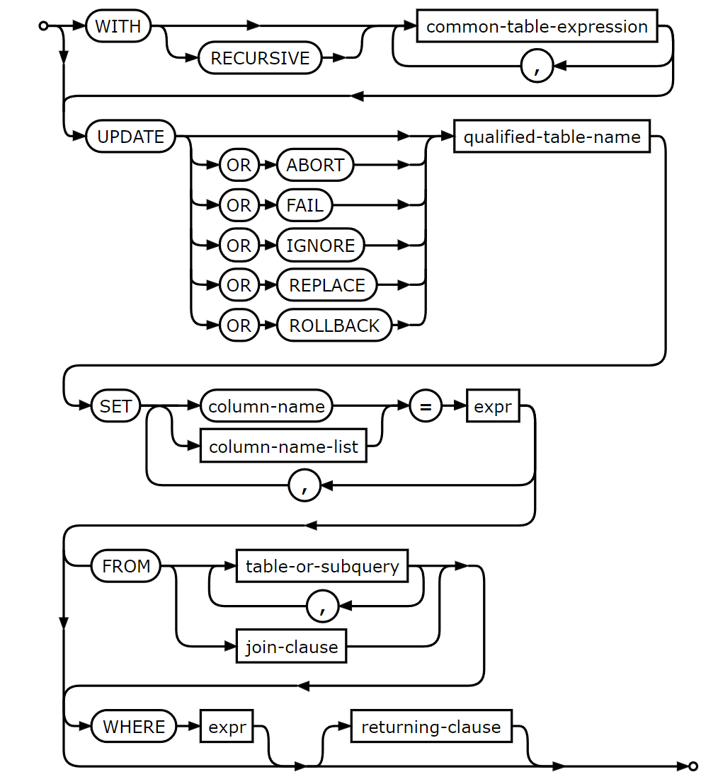
Session: SQL UPDATE
Data is often changed after it is entered in a database.
SQL provides the UPDATE statement.
The complex syntax is in the chart to the right:
A simple form if the syntax follows:
UPDATE TableName SET Field = value
WHERE Selection Criteria
Notes:
https://www.sqlite.org/lang_update.html

Slide 61
Session: SQL UPDATE
Write a query to change Mercy Schroeder's last name to Smith.
The question requires a little more qualification.
Two athletes could have the same first and last name (The given data doesn't have this).
Either we can change all athletes with the first name Mercy and last name Schiroeder to Smith or we can specify the exact athlete by their IDAthlete value.
We do the latter:
UPDATE LastName SET LastName = 'Smith' WHERE IDAthlete = 4
Athlete
IDAthlete | FirstName | LastName | CountryCode | Gender
1 | Lillie | Gill | FRA | F
2 | Lyla | Suarez | ITA | F
3 | Gwendolyn | French | MEX | F
4 | Mercy | Schroeder | LTU | F
5 | Iliana | Velazquez | AUS | F
Notes:
https://www.sqlite.org/lang_update.html

Slide 62
Session: SQL UPDATE
Be VERY careful to include a WHERE clause.
Otherwise, every record in the table is updated.
Notes:
https://www.sqlite.org/lang_update.html

Slide 63
Session: SQL UPDATE
Write a query to add an hour to the start time of the race with IDRace = 1.
One technique to writing an UPDATE query, is to first write a SELECT query showing what the data will look like before it is updated.
Let's do that:
SELECT strftime('%H:%M:%S',StartTime, "+60 minutes") AS NewStart FROM Race WHERE IDRace=1
Result Set
New Start
08:00:00
Rewrite the SELECT as an UPDATE
UPDATE RACE SET StartTime = strftime('%H:%M:%S',StartTime, "+60 minutes") WHERE IDRace=1
Race
IDRace | IDEvent | RaceDate | StartTime | Distance | DistanceUnits | Gender
1 | 1 | 08/24/2023 | 07:00 | 35 | km | MF
2 | 1 | 08/24/2023 | 10:50 | 20 | km | M
3 | 1 | 08/24/2023 | 07:15 | 20 | km | F
Notes:
https://www.sqlite.org/lang_update.html

Slide 64
Session: SQL UPDATE
Sometimes data needs to be cleaned up.
A good example is when a column has "" as an empty string and the value should be null.
Null and the empty string are not the same!
UPDATE can be used to correct this.
First, review the NULLIF function:
NULLIF takes two parameters and returns the first one if they are not equal and null if they are.
This is useful to check a field against a scalar value, like an empty string.
NULLIF(FieldName, "") returns the field value if it is not the empty string and null if it is.
Notes:
https://www.sqlite.org/lang_update.html

Slide 65
Session: SQL UPDATE
The syntax to update a field with null if it contains the empty string is therefore:
UPDATE TableName SET ColumnName = NULLIF(ColumnName, "");
To update the IDVideo field of the VideoObservation table to null if it contains the empty string use:
UPDATE VideoObservation SET IDVideo = NULLIF(IDVideo, "");
Notes:
https://www.sqlite.org/lang_update.html

Slide 66
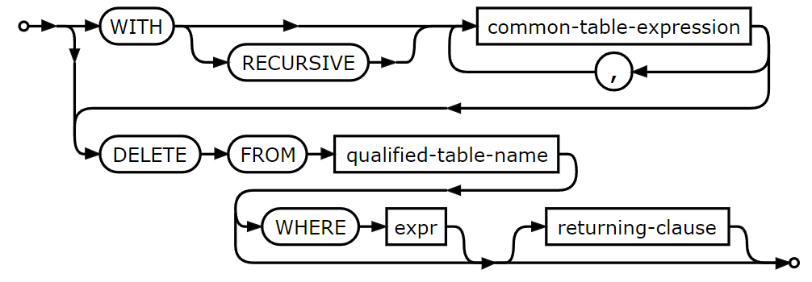
Session: SQL DELETE
Data may be removed from table using the DELETE statement.
The syntax is simple:
DELETE FROM TableName WHERE DeleteCondition;
Records are removed from the table specified by TableName based on a conditions specified it the WHERE clause.
Notes:
https://www.sqlite.org/lang_update.html

Slide 67
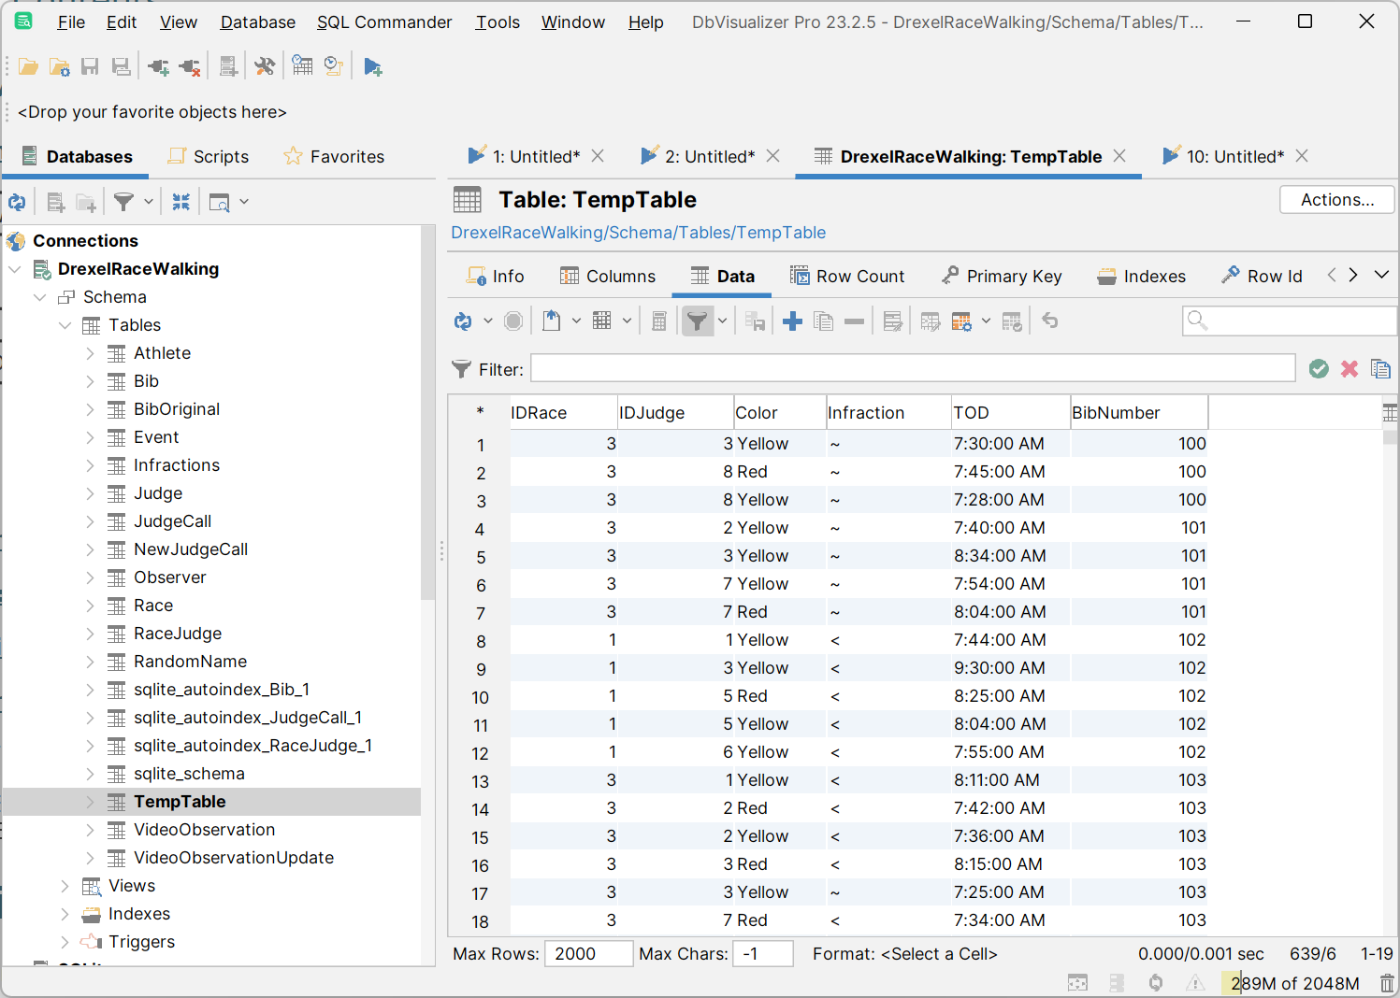
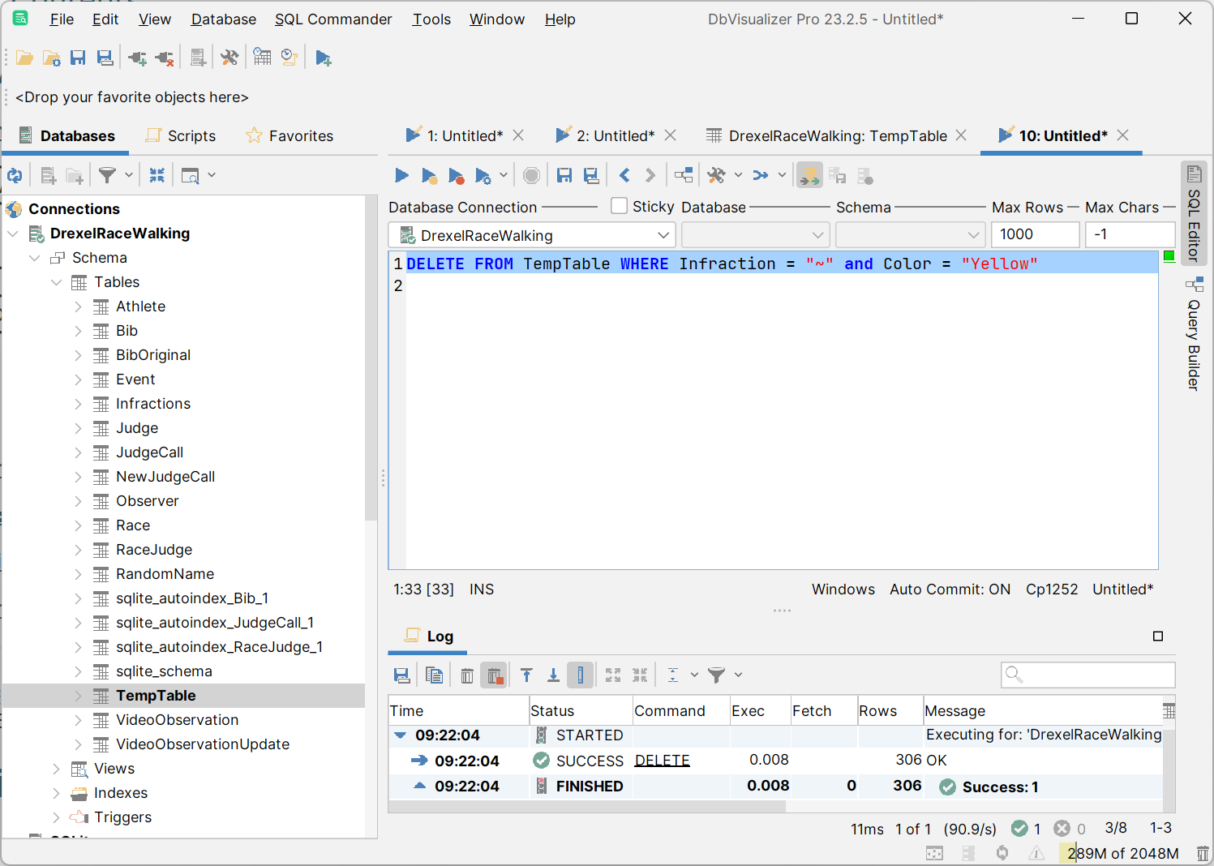
Session: SQL DELETE
Observe removing all the records in TempTable (a copy of the JudgeCall table) where the Infaction is ~ and the Color is Yellow.
Note, before the DELETE there are 639 records.
306 records are deleted.
DELETE FROM TempTable WHERE Infraction = "~" and Color = "Yellow"
Notes:
https://www.sqlite.org/lang_update.html

Slide 68
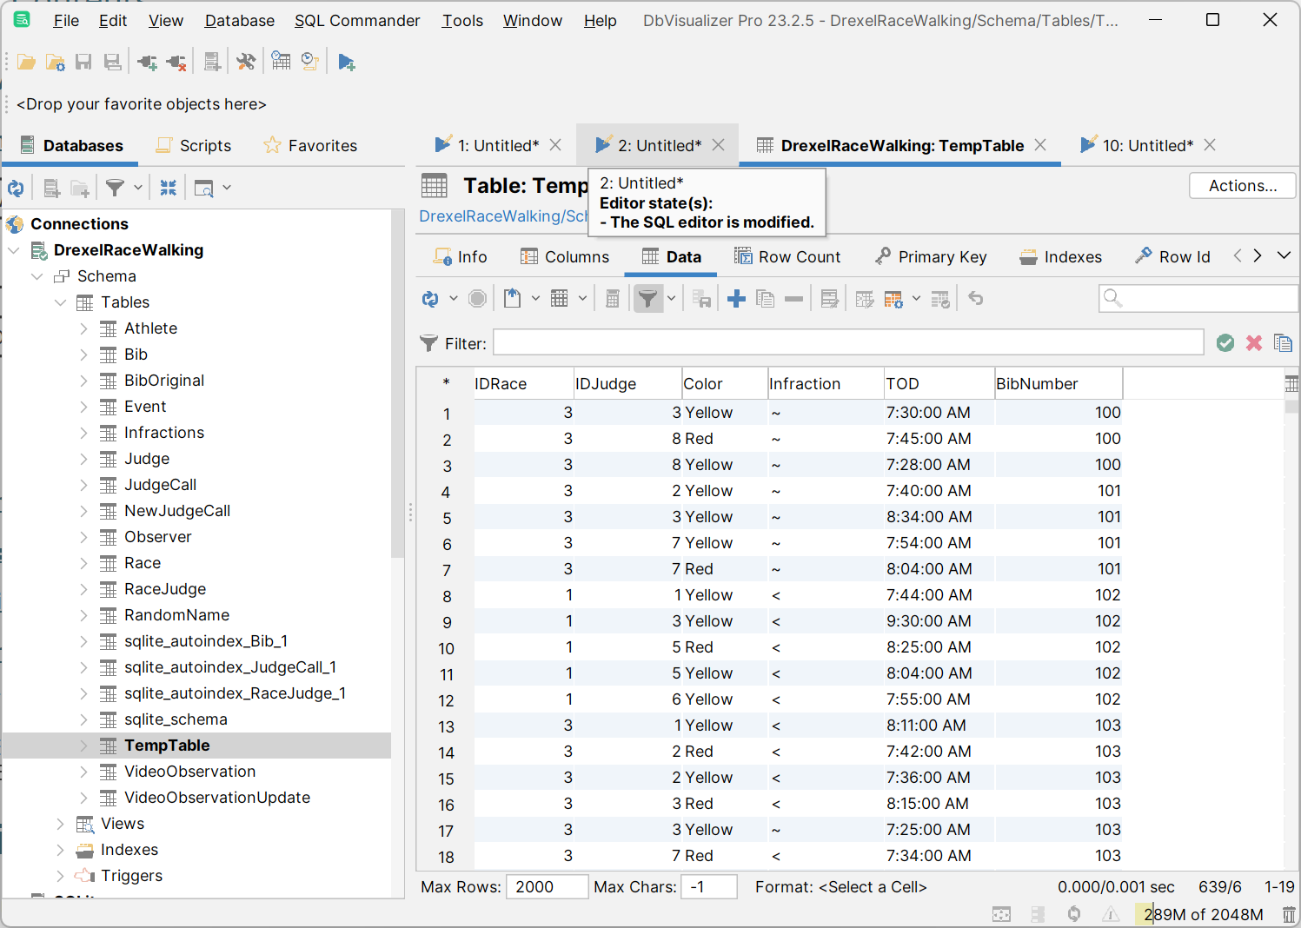

Session: SQL DELETE
However, observe the TempTable.
Why are the records still there?
In order to see the changes, click the Refresh button.
Notes:
https://www.sqlite.org/lang_update.html

